Slide 1
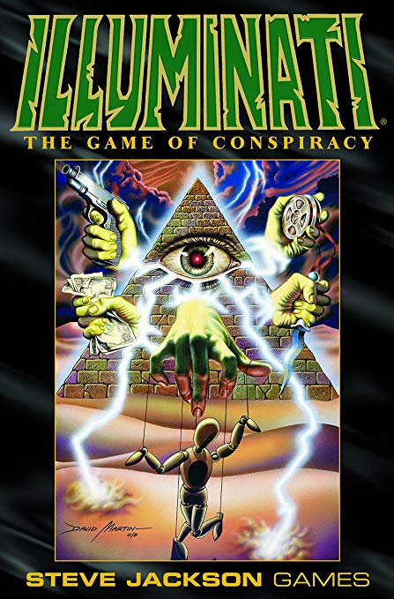
Team ARK: Alex Schein, Richard Toledo, Kathya Marquez

Slide 2
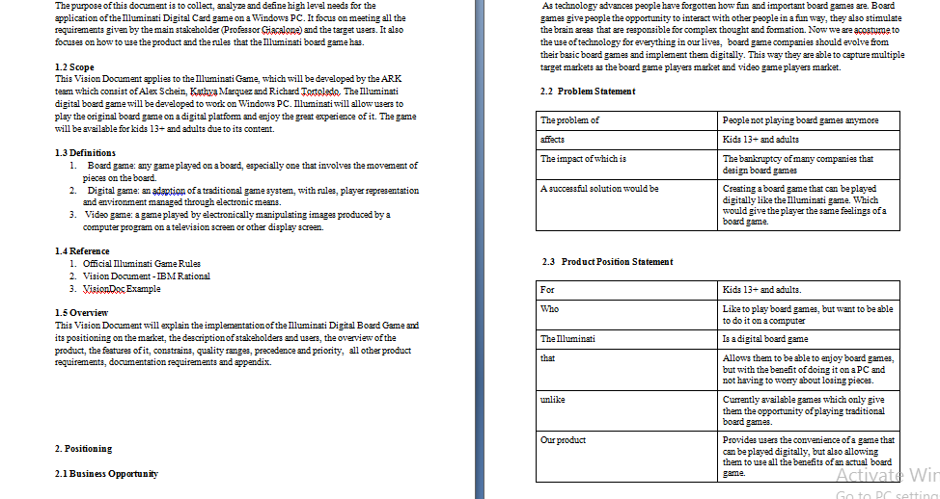
Crafting the Vision Document
-Overall mostly straightforward;
- Gave general outline of how everything would happen and also made us aware of who was involved and the scope of the project
-Introduced “new” aspects we don’t usually think about- environmental risks, hardware risks, etc.
- Extremely Useful in listing out the product specifications - “bettered” our understanding of Illuminati
- Gave us a “vision”

Slide 3
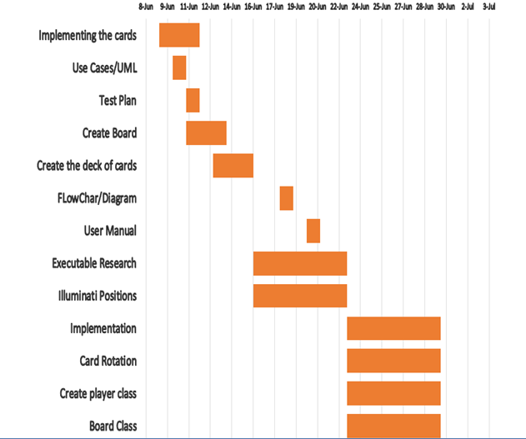
Project Planning
First portion of the document felt very similar to the vision doc- overview of what Illuminati is, environment requirement for Illuminati - the overview felt too similar…
Creating a general timeline felt useful but actual implementation didn’t happen until last week….
Risk management and delivery plan were helpful in providing a schedule
Management roles and planning was useful in the end for creating the end product
While it felt very repetitive, it was mostly beneficial in the end product

Slide 4
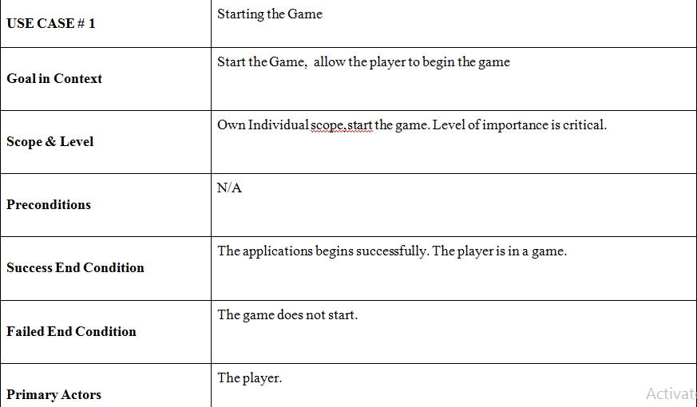
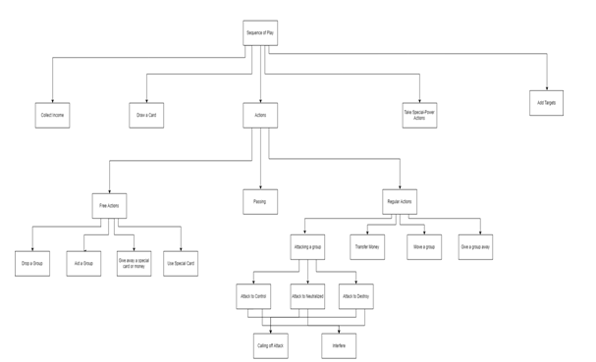
Use Casing and crafting the UML
UML allows us to imagine how classes will interact with one another and cohesion occurs in the program
Use Cases are great for determining
Criticisms:
-Felt extremely time consuming- the use cases
- Use Casing is great for accounting all possible outcomes,
- Felt like the due dates assigned for each use case tended to overlap with the Project Plan (not necessarily bad) but felt repetitive

Slide 5
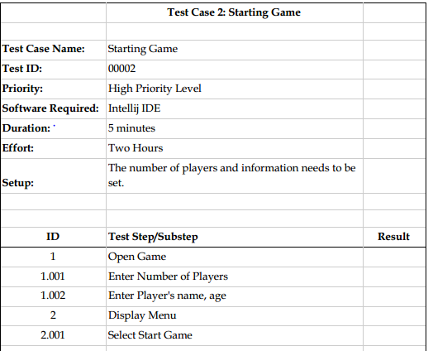
The Test Plan & The User Manual
-The test plan

Slide 6
Implementation Phase

Slide 7
Demo

Slide 8

Product Reflection
Start and End work great!
The game represents the original Illuminati fairly well. The cards represent the original and the graphics feel fresh.
The Documentation to create the product feels fulfilled- the end result represents the goals set when we imagined the game.
-We’re Proud of what we Accomplished with the time constraints!

Slide 9
Overall Thoughts on SoftWare Engineering
There is a lot of planning and thought aside from coding before software is released for a market.
Teamwork is crucial to making things happen.
Communication is key to a successful product.
Time management is crucial to meeting deadlines and creating high quality work.
Software Engineering is much more complex than Software Development.

